Slide 1
EARHQUAKE PREDICTION MODELUSING PYTHON
Gowtham.r/VVCET

Slide 2
Topic
Start building the earthquake prediction model by using python loading and preprocessing the dataset

Slide 3
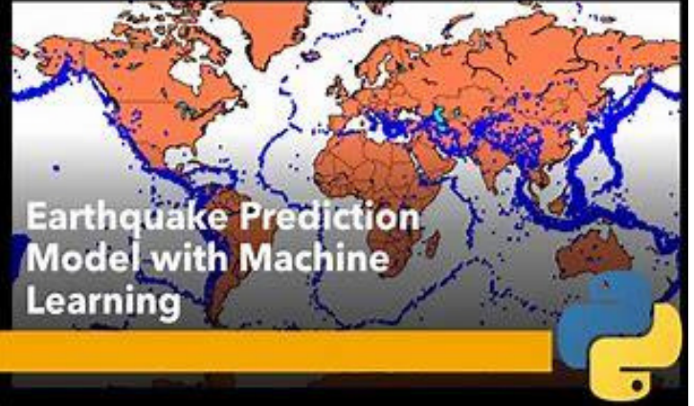

Slide 4
EARTHQUAKE PREDICTION
INTRODUCTION
It is well known that if a disaster has happened in a region, it is likely to happen there again.
Some regions really have frequent earthquakes, but this is just a comparative quantity compared to other regions.
predicting the earthquake with Date and Time, Latitude and Longitude from previous data is not a trend which follows like other things, it is natural occurring.

Slide 5
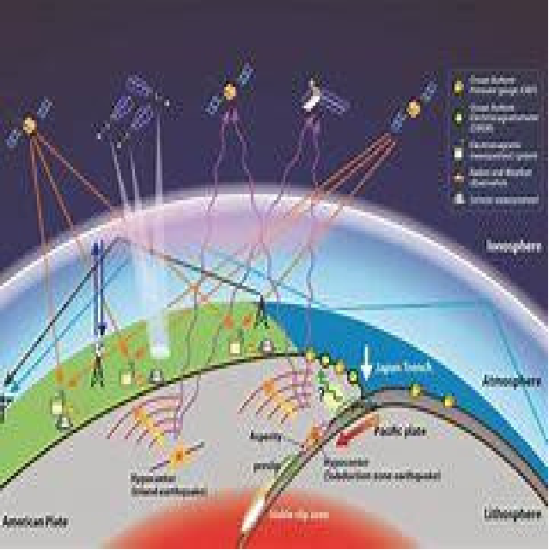

Slide 6
GIVEN DATASET
magnitude cdi mmi tsunami sig nst dmin gap depth latitude longitude
count 782.000000 782.000000 782.000000 782.000000
782.000000 782.000000 782.000000 782.000000
782.000000 782.000000 782.000000
mean 6.941125 4.333760 5.964194 0.388747 870.108696
230.250639 1.325757 25.038990 75.883199 3.538100
52.609199
std 0.445514 3.169939 1.462724 0.487778 322.465367
250.188177 2.218805 24.225067 137.277078
27.303429 117.898886
min 6.500000 0.000000 1.000000 0.000000 650.000000
0.000000 0.000000 0.000000 2.700000 -61.848400 -
179.968000

Slide 7
25% 6.600000 0.000000 5.000000 0.000000 691.000000
0.000000 0.000000 14.625000 14.000000 -14.595600 -
71.668050
50% 6.800000 5.000000 6.000000 0.000000 754.000000
140.000000 0.000000 20.000000 26.295000 -2.572500
109.426000
75% 7.100000 7.000000 7.000000 1.000000 909.750000
445.000000 1.863000 30.000000 49.750000 24.654500
148.941000
max 9.100000 9.000000 9.000000 1.000000 2910.000000
934.000000 17.654000 239.000000 670.810000
71.631200

Slide 8
IMPORT LIBRARIES:
PROGRAM
Import pandas as pd
Import numpy as np
2.LOAD THE DATASET
Load your dataset into pandas data frame. You can typically find earthquake prediction model using python datasets in CSV format .

Slide 9
PROGRAM:
df=pd.read_csv(‘E:\USA_Earthquake.csv’)
Pd.read()

Slide 10
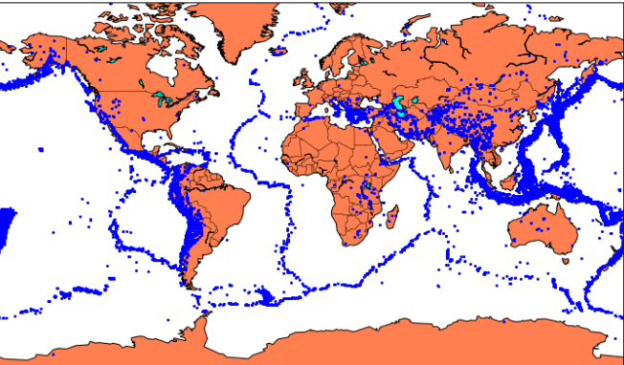

Slide 11
Splitting the Data:
Firstly, split the data into Xs and ys which are input to the model and output of the model respectively.
Here, inputs are Time stamp, Latitude and
Longitude and outputs are Magnitude and Depth.
Split the X s and y s into train and test with validation.
Training dataset contains 80% and Test dataset contains 20%

